Slide 1
SECURE AUDITING AND DEDUPLICATIng DATA IN CLOUD
ANJU M
2022MSIT02

Slide 2
ABSTRACT
The development of cloud computing technology in the past decade, outsourcing data cloud storage an attractive trend, benefiting from the heavy data maintenance and management sparring efforts.
However, with cloud storage outsourcing it is not completely reliable, which is how to delete duplicate data in the cloud, while achieving a complete security audit.
The specific purpose of SecCloud is to ensure data integrity and eliminate duplicate data in the cloud, particularly within the system.
SecCloud introduces an audited entity that utilizes MapReduce in the cloud.

Slide 3
FRONTEND : JAVA BACKEND: Mysql

Slide 4
EXISITING SYSTEM
Cloud storage service providers such as Dropbox, Google Drive, Mozy, and others perform deduplication to save space by only storing one copy of each file uploaded.
However, if clients conventionally encrypt their data, storage savings by deduplication are totally lost.
This is because the encrypted data are saved as different contents by applying different encryption keys.
Existing industrial solutions fail in encrypted data deduplication.

Slide 5
disADVANTAGES
By distributing multiple copies, the advantages of high availability and encryption are applied to each file across a variety of intermediate desktops. However, replication consumes significant storage.
Traditional deduplication systems may pose security risks, especially if they are not designed with robust encryption and access control mechanisms.
Identical data copies of different users will lead to different cipher texts, making deduplication impossible.

Slide 6
Proposed system
SecCloud introduces a cloud environment where the audited entity is hosted, aiding customers in generating labels and auditing the integrity of data stored in the cloud before uploading.
To encrypt a file using convergent encryption, a client compute a cryptographically strong hash of the file content. Customers get a convergent key from each and every unique data copy and encrypt the unique data copy with the convergent key.
The integrity of the data we propose is a method of third party auditor to validate the process.
To discover the duplicate copies, the customer first sends the tag to the tpa to verify if the duplicate copy has been already available. If not then it uploads file to the cloud server.

Slide 7
advantages
Client-side deduplication involves performing deduplication on the client side before data is encrypted and uploaded, preserving the benefits of deduplication while ensuring data security and privacy.
Convergent encryption involves deriving encryption keys from the content itself, allowing identical content to produce the same ciphertext, enabling deduplication even with encrypted data.
The auditor audits and validates the uploaded file on time.

Slide 8
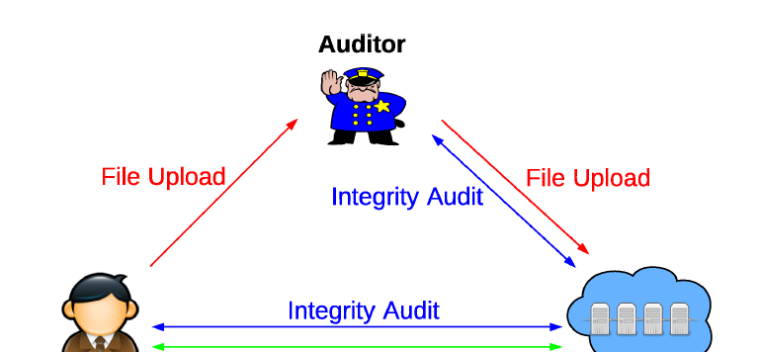
ARCHITECTURAL DIAGRAM

Slide 9
modules
User Setup Wizard
HashCode generation
File To TPA and Validation
File uploading to cloud with (key)
File download

Slide 10
user Setup wizard
In User setup wizard , user have to enter the personal information to register into application.
After registeration, user can login into the process through the username and password.

Slide 11
hashcode generation
User generates the hashcode for the particular file and hand over the encrypted file and hashcode to the Third Party Auditor.
An auditing protocol with key exposure resilience is composed by four algorithms (AES, Key Update, DES, MD5), Current security model considers the notion of the forward security and data possession property.

Slide 12
File To TPA and Validation
The cloud is allowed to get the client’s secret key for cloud storage auditing in one certain time period.
In TPA process, the TPA get the user file and hashcode from the user.
Now TPA generate the hashcode for user file.
Then they verify the generated hashcode with user hashcode whether it is same and different.
After verifying the hashcode, it forwards to the cloud server.

Slide 13
File Uploading to cloud with(Key)
In file uploading, user can upload the file along with corresponding authenticators to the cloud.
Each and every files are verified by the TPA to reduce duplication in the cloud server.
The file is encrypted using Advanced Encryption Standard algorithm for security purpose.

Slide 14
File Download
The cloud stores these files for the client and provides download service if the client requires.

Slide 15
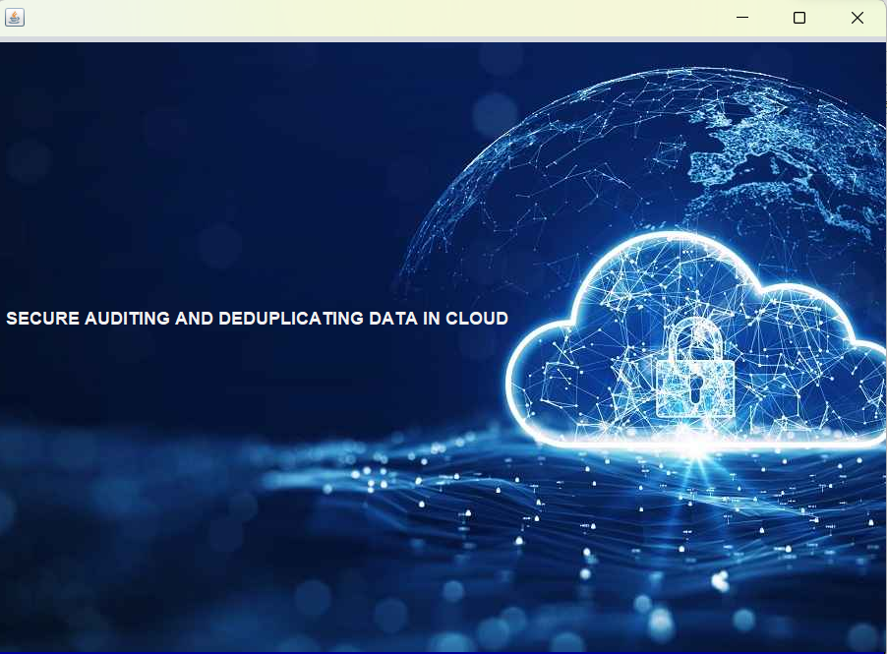
Screenshots

Slide 16
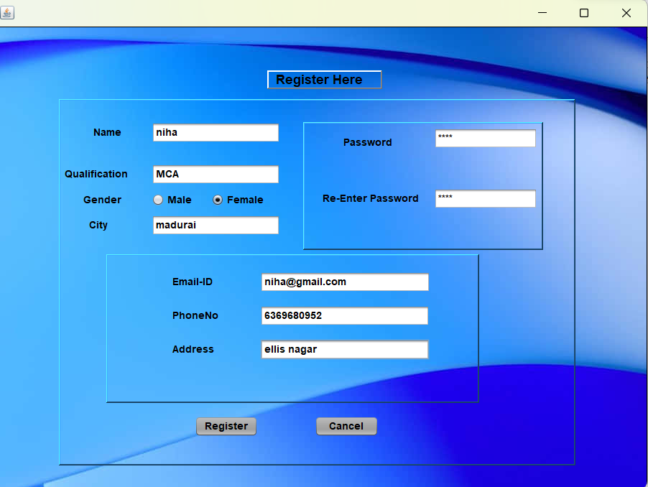
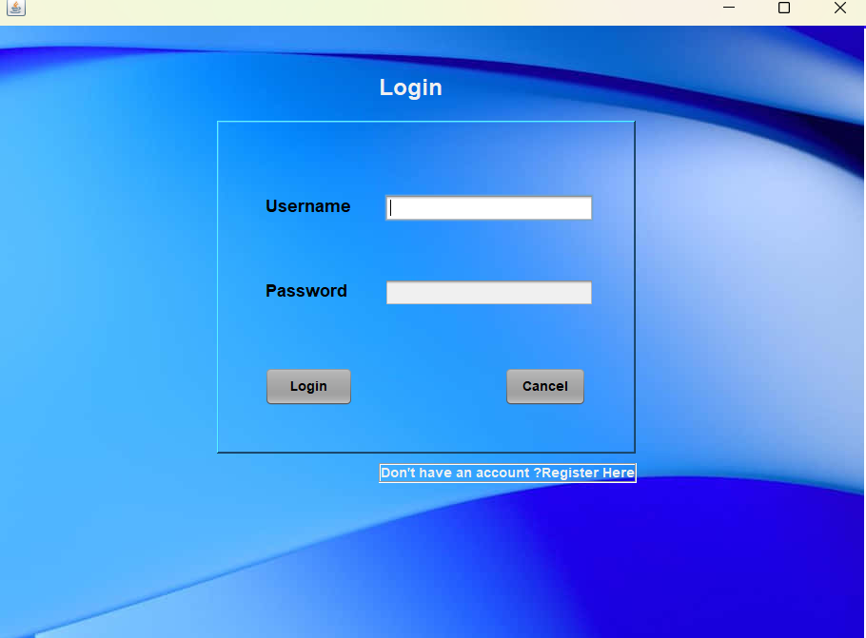
user Setup wizard
Registration
Login

Slide 17
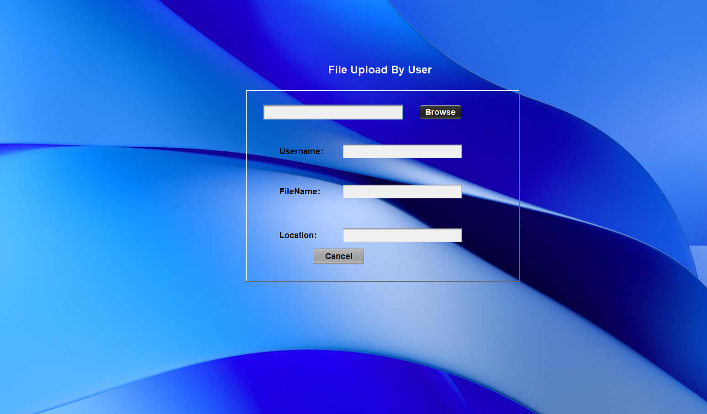
File upload by user

Slide 18
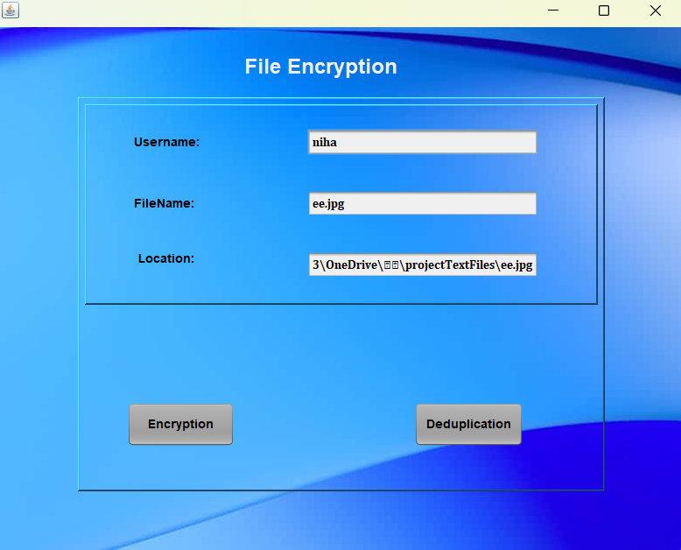
File encryption

Slide 19
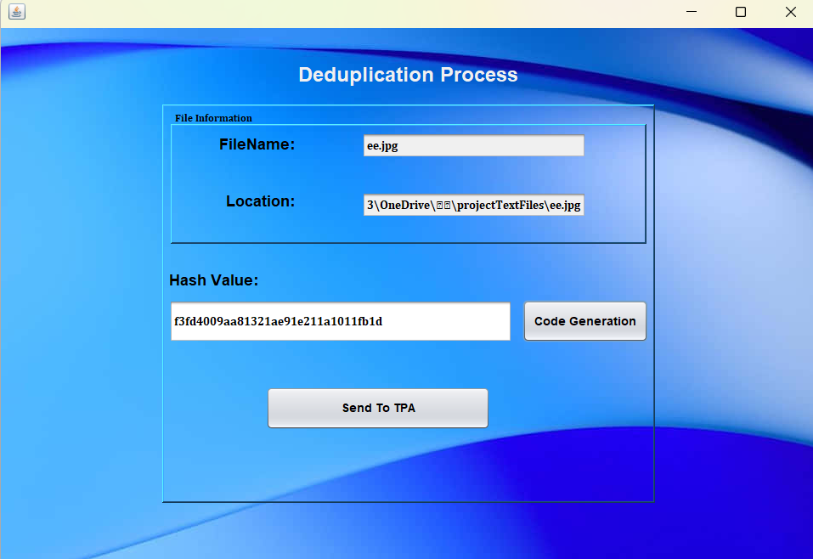
Deduplication process

Slide 20
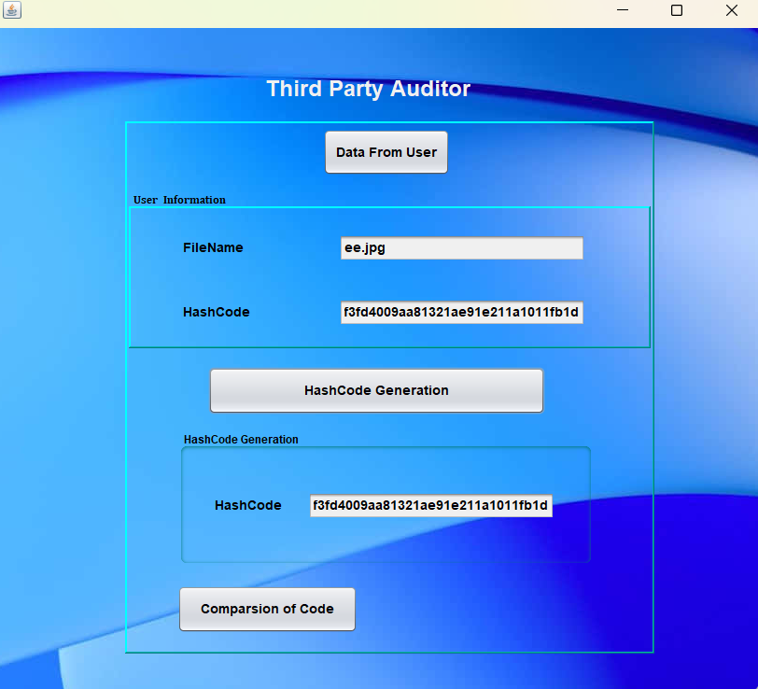
Third party auditor

Slide 21
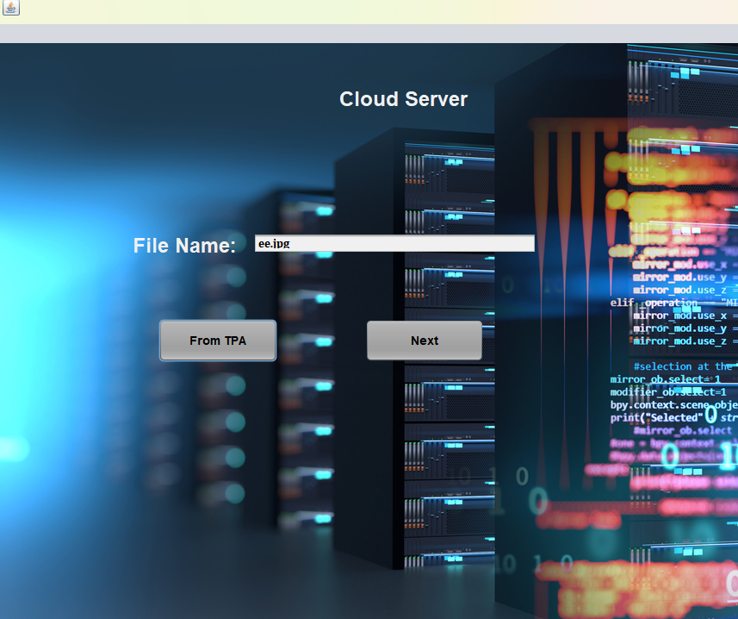
Cloud server

Slide 22
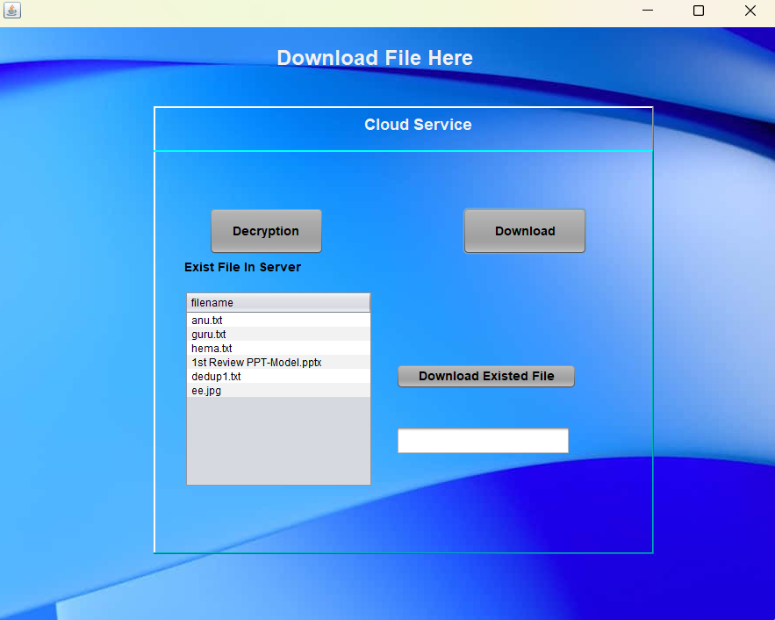
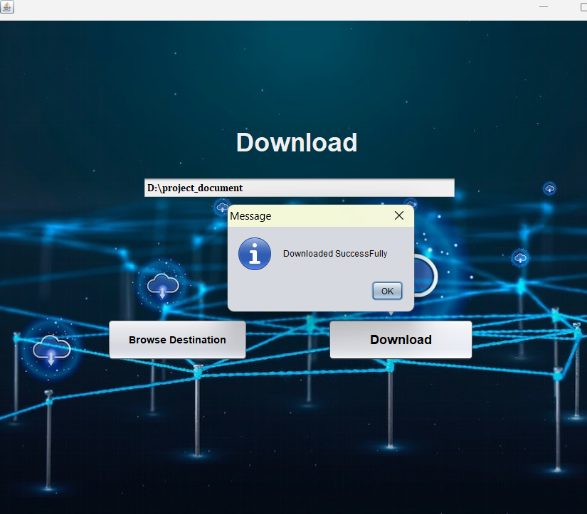
Download

Slide 23
Future enhancement
The system still has a scope of using a Secure Hashing Algorithm (SHA) and digital signature verification to check the authenticity of the data uploaded by the user.
The system for data deduplication could be migrated to other platforms such as smartphones, Personal Computers (PCs), etc.
This system cloud is used in other web services such as messaging services, web hosting, etc. to make them system more efficient and handle more data volumes.

Slide 24
Thank you!

